Slide 1


Employee Survey 2023 – Results

Slide 2
TABLE OF CONTENT
# | Content | Slide Number
1 | Survey Methodology Recep | 3 – 4
2 | Survey Results Overview | 5 – 8
3 | Key Dimension Results | 9 – 15
4 | Key Relationship Results | 16 – 21
5 | PX Statements | 22 – 23
6 | ENPS | 24 - 25
7 | Strengths & Opportunities | 26 – 28
8 | Key Dimension Results High-level Breakdown into Departments | 29 – 33
9 | Internal Benchmark with Previous Year(s) | 34 – 35
10 | External Benchmark | 36 - 38
11 | Sentiment Analysis on open-ended questions | 39 - 41

Slide 3

Survey Methodology (Recap)

Slide 4
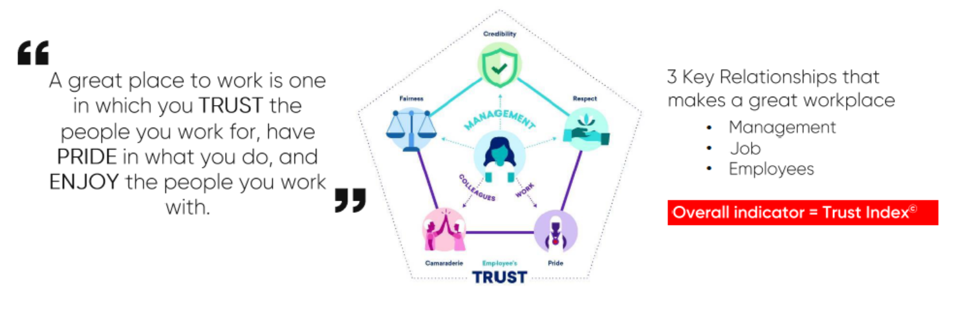
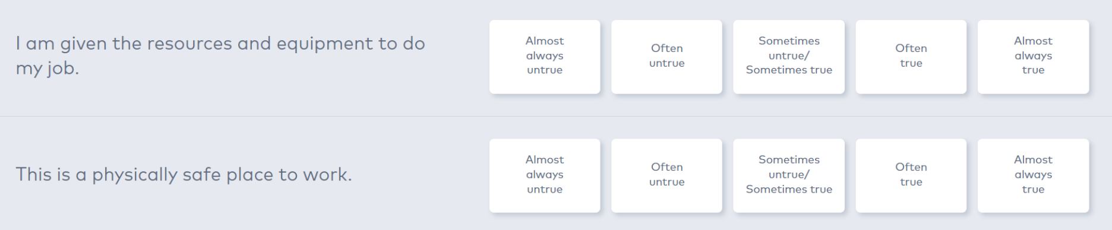
Survey Methodology Overview
Methodology: "Trust" - based on trusting the company to do the right thing, measuring 5 dimensions of 3 key workplace relationships as you see in the diagram below.
Survey consists of 61 statements. The statements are measured in 5 points scale; ‘’Almost always true/ Often true” as Positive responses, “Sometimes untrue/ Sometimes true” as Neutral responses and “Almost always untrue/ Often untrue” as Negative responses.
Negative
Neutral
Positive

Slide 5
Survey Results Overview

Slide 6
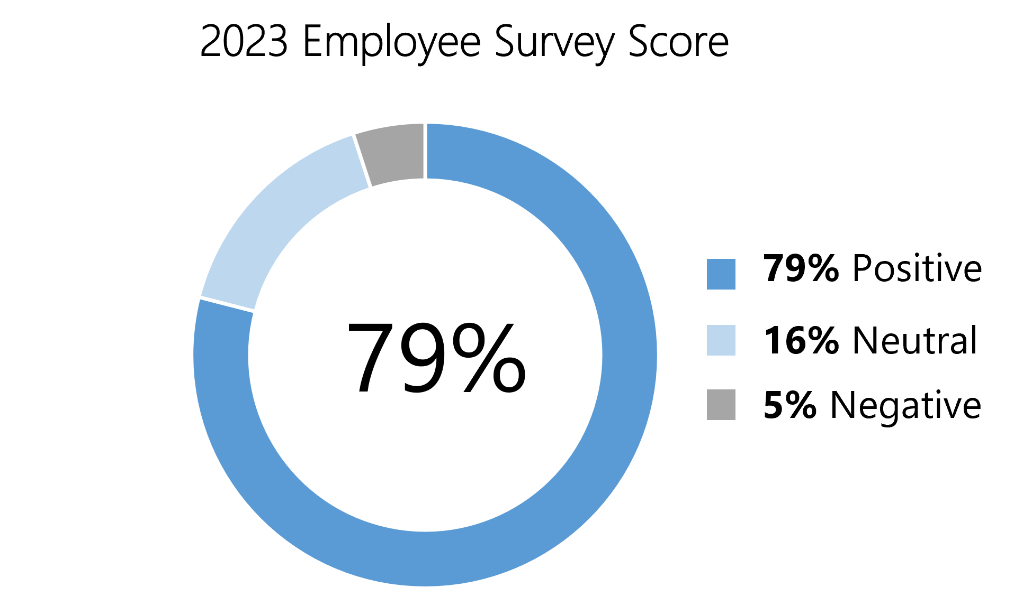
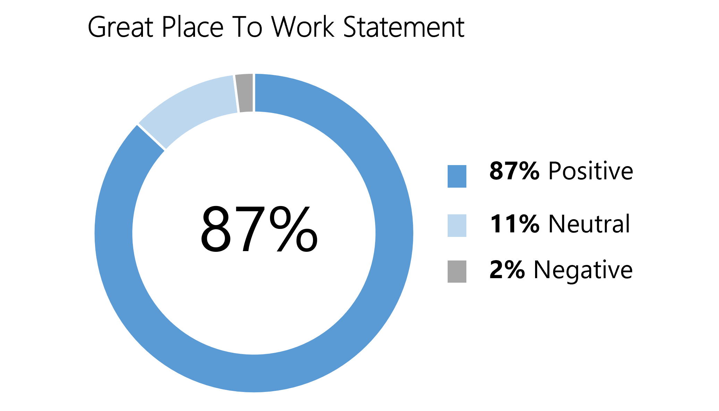
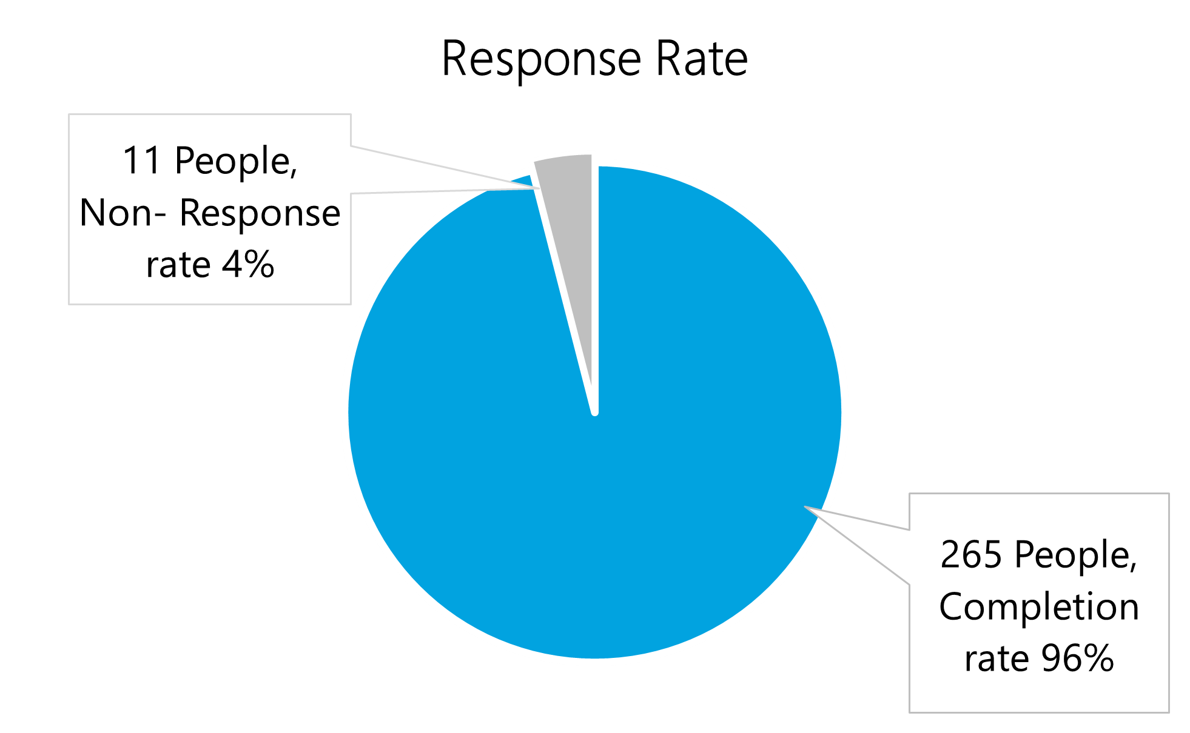
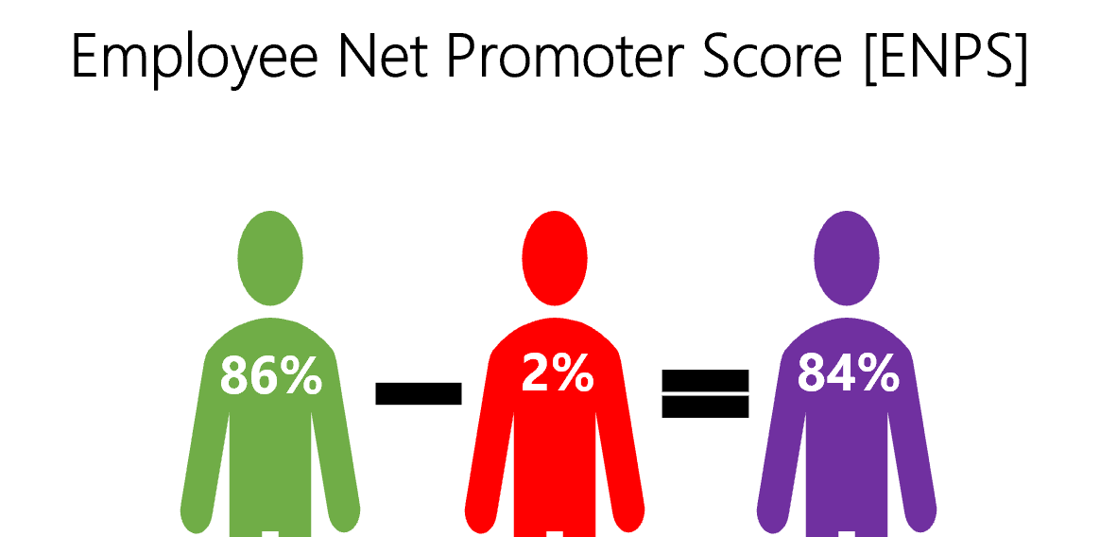
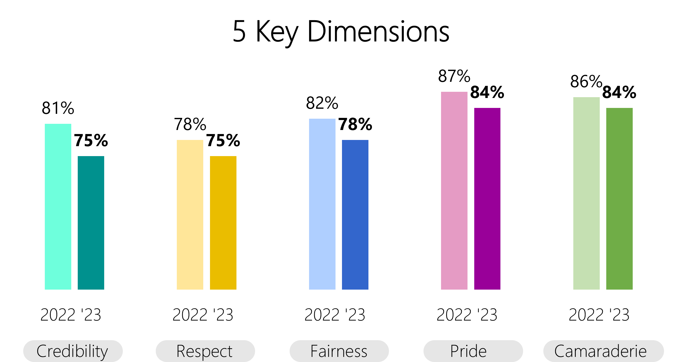
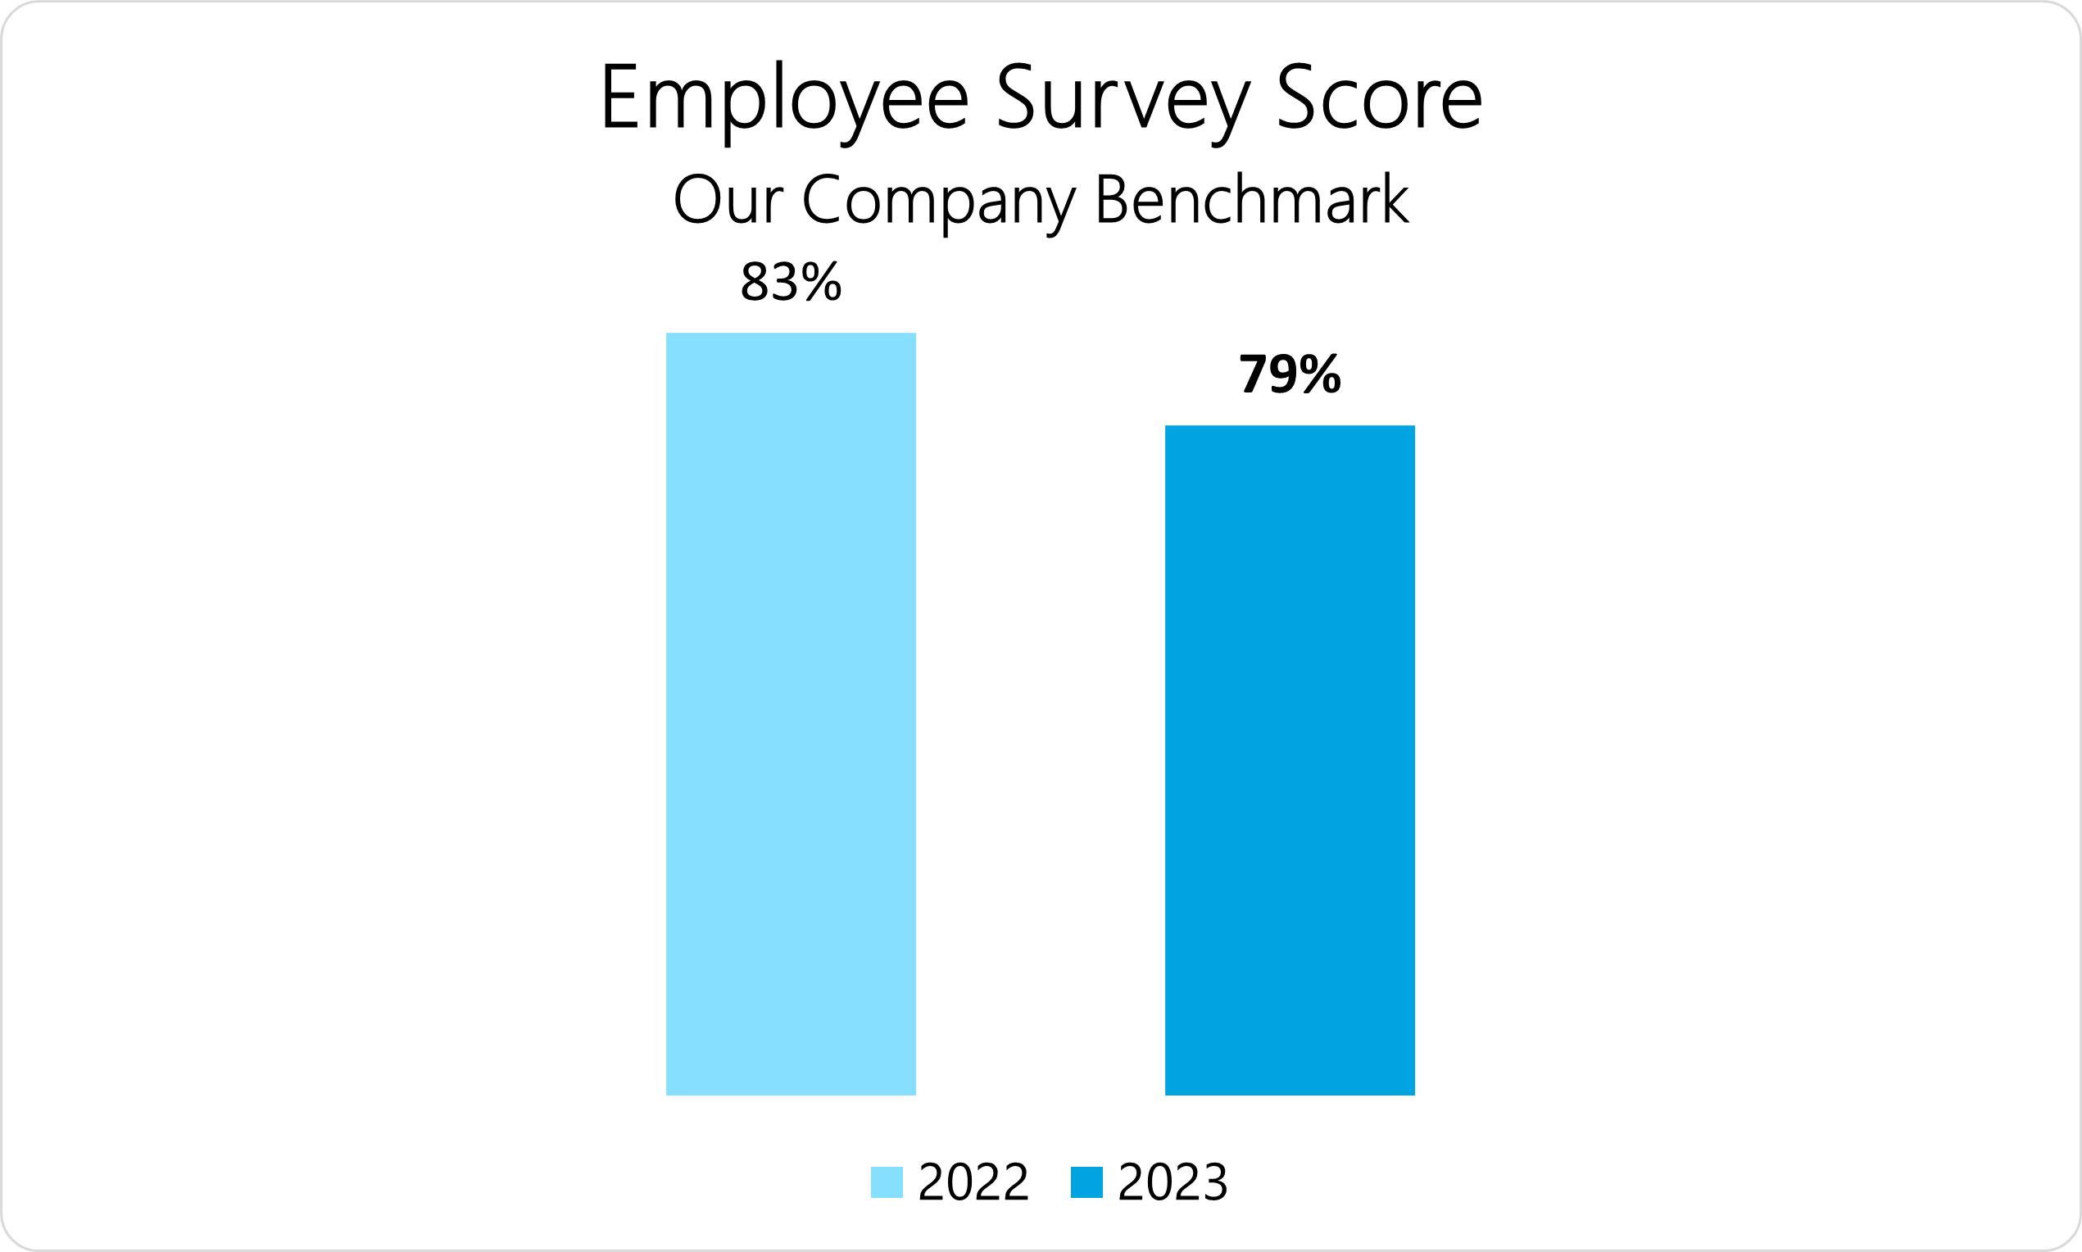
Employee Survey 2023 Dashboard

Slide 7
2023 Employee Survey Score (EES Score) Overview
79% Positive
16% Neutral
5% Negative
of our employees agreed with all of the statements from the survey.
 | 2022 |  |  | 2023
# | Positive | Neutral | Negative | Positive | Neutral | Negative
EES Score | 83% | 13% | 5% | 79% | 16% | 5%
Notes:
This score is an assessment of overall performance capturing all aspects of the survey equally.
According to the results, 79% of the responses to the statements were “Almost Always True” or ‘’Often True”. 16% respondents as ‘’Sometimes Ture/ Sometimes Untrue” whereas only 5% of the responses were ‘’Almost Always Untrue” or “Often Untrue”.
The Employee Engagement Score dropped about 4% compared to last year’s score.
To gain deeper insights into the reasons behind this decline, it is beneficial to examine the results of 5 key dimensions; Credibility, Respect, Fairness, Pride and Camaraderie.

Slide 8
Taking everything into account, I would say this is a Great Place to Work.
87% Positive
11% Neutral
2% Negative
of our employees agreed with this statement.
# | 2022 |  |  | 2023
 | Positive | Neutral | Negative | Positive | Neutral | Negative
GPTW Statement | 89% | 9% | 1% | 87% | 11% | 2%
Notes:
When comparing this year's survey score of 87% to last year's score of 89%, it is evident that there has been a slight decrease in the overall employee satisfaction level.
Although both scores indicate a positive response from the participants, there is a noticeable difference in the sample size. This year results are based on the sample size of 276 people whereas last year’s sample size was 231.

Slide 9
Key Dimension Results
(Credibility, Respect, Pride, Camaraderie & Fairness)

Slide 10
Key Dimensions Results Overview
 | 2022 |  |  | 2023
# | Positive | Neutral | Negative | Positive | Neutral | Negative
Credibility | 81% | 14% | 5% | 75% | 20% | 5%
Respect | 78% | 16% | 6% | 75% | 18% | 7%
Fairness | 82% | 13% | 5% | 78% | 16% | 6%
Pride | 87% | 10% | 3% | 84% | 13% | 3%
Camaraderie | 86% | 11% | 3% | 84% | 14% | 2%
Notes:
According to this year results, Pride and Camaraderie are the highest with average scores of 84% whereas Credibility and Respect were the lowest with average scores of 75%.
When compared the data from 2022, it showed a significance drop of 6% in Credibility score. This decline suggests that employees perceive a lower level of trustworthiness or belief in the information and actions of the company compared to last year.
The Fairness score decreased from 82% in 2022 to 78% in 2023. This decline implies that employees perceive a decrease in equitable treatment and decision-making processes within the company.
The comparison of the remainders – Respect, Pride and Camaraderie also showed a decrease of 2% - 3% respectively from last year’s results.

Slide 11
Deep Dive into Credibility – Key Dimension Results
 | 2022 |  |  | 2023
# | Positive | Neutral | Negative | Positive | Neutral | Negative
Credibility | 81% | 14% | 5% | 75% | 20% | 5%
Communication | 79% | 15% | 6% | 74% | 20% | 6%
Competence | 79% | 16% | 5% | 73% | 21% | 6%
Integrity | 86% | 11% | 3% | 78% | 18% | 4%
Notes:
Each dimension is measured by 4 focus areas. Under Credibility dimension, it includes Credibility Paulse, Communication, Competence and Integrity.
The overall Credibility score decreased for 6% compared to last year’s result.
Among 4 focus areas, the Integrity score was the lowest with the decline from 86% in 2022 to 78% in 2023.

Slide 12
Deep Dive into Respect – Key Dimension Results
 | 2022 |  |  | 2023
# | Positive | Neutral | Negative | Positive | Neutral | Negative
Respect | 78% | 16% | 6% | 75% | 18% | 7%
Collaboration | 72% | 19% | 9% | 70% | 22% | 8%
Support | 74% | 18% | 8% | 69% | 21% | 10%
Caring | 83% | 13% | 4% | 81% | 15% | 4%
Notes:
Out of 4 pillars, the score of Support is the lowest comparing to the score from 2022. It has decreased for 2% since last year’s result.
It is worth noting that the statement “I am offered training or development to further myself professionally” under Respect dimension scores the lowest with only 46% of positive responses.

Slide 13
Deep Dive into Fairness – Key Dimension Results
 | 2022 |  |  | 2023
# | Positive | Neutral | Negative | Positive | Neutral | Negative
Fairness | 82% | 13% | 6% | 78% | 16% | 7%
Justice | 88% | 8% | 4% | 88% | 9% | 3%
Equity | 80% | 14% | 5% | 76% | 17% | 7%
Impartiality | 75% | 17% | 8% | 67% | 21% | 12%
Notes:
It shows that the score of Justice remains unchanged in both years, which is 88%.
However, the scores of Fairness Paulse and Equity have decreased for 4% when compared the results of last year.
Among all, Impartiality score is the lowest which dropped from 75% in 2022 to 67% in 2023.

Slide 14
Deep Dive into Pride – Key Dimension Results
 | 2022 |  |  | 2023
# | Positive | Neutral | Negative | Positive | Neutral | Negative
Pride | 87% | 10% | 3% | 84% | 13% | 2%
Corporate Image | 88% | 9% | 2% | 85% | 13% | 2%
Team | 83% | 13% | 4% | 81% | 16% | 3%
Personal Job | 88% | 9% | 3% | 88% | 9% | 2%
Notes:
According to the chart, the score of Personal Job remains constant as 88% in 2022 and 2023. Basically, Personal Job pillar is measured by two statements “I feel I make a difference here” and “My work has special meaning: this is not "just a job."
Contrarily, the scores of Pride Paulse and Corporate Image have declined about 3% respectively compared to the result of 2022.

Slide 15
Deep Dive into Camaraderie – Key Dimension Results
 | 2022 |  |  | 2023
# | Positive | Neutral | Negative | Positive | Neutral | Negative
Camaraderie | 86% | 11% | 3% | 84% | 14% | 2%
Community | 83% | 12% | 4% | 77% | 21% | 2%
Hospitality | 85% | 13% | 2% | 84% | 14% | 2%
Intimacy | 89% | 9% | 2% | 85% | 12% | 3%
Notes:
According the results, the score of Community falls from 83% in 2022 to 77% in 2023 resulting in 6% decrease in general. This is measured by the statement “You can count on people to cooperate”.
On the other hand, the Hospitality score remains steady with only 1% decline from last year’s result.
There has been a slight decease in two other pillars, Camaraderie Paulse and Intimacy when compared to the scores of 2022.

Slide 16
Key Relationship Results
(Employee, Job, Management)

Slide 17
Key Relationship Results | Employees x Job x Management
Notes:
The survey also evaluates employees’ perspective over 3 key relationships that are Employees (measuring Engagement), Job (measuring Innovation) and Management (measuring Leadership Behavior).
Each dimension is measured by 6 ~ 15 statements such as ‘’I am proud to them others I work here.” “I feel I can make a difference here.” “Management is honest and ethical in its business practices.”

Slide 18
Statements measuring “Employee”– Key Relationship Results
Positive
Neutral
Negative

Slide 19
Statements measuring “Job” – Key Relationship Results
Positive
Neutral
Negative

Slide 20
Statements Measuring “Management/Leadership Behavior” – Key Relationship Results
Positive
Neutral
Negative

Slide 21
Specific Statement on Confidence in Leadership
*2022 Result not available

Slide 22
Statement Results Measuring Employee Experience

Slide 23
Statements related to “Campus Facility”
Statements related to “Work-Life Balance”
2022
2022
2023
2023
2022
2023
2022
2023
2022
2023

Slide 24
Employee Net Promoter Score (ENPS)

Slide 25

Employee Net Promoter Score [ENPS]
Result
2023
86%
2%
84%
Result
2022
88%
2%
86%

Slide 26
Strengths & Opportunities
(Top 10 Statements & Bottom 10 Statements)

Slide 27
Strengths [Top 10 Statements]
Our employee survey identified the top 10 statements with the highest scores, indicating strong positive sentiment among employees. These statements highlight the company's strengths and areas where employees feel most satisfied, providing valuable insights for recognizing and fostering a positive work environment.

Slide 28
Opportunities [Bottom 10 Statements]
The survey results revealed the bottom 10 statements with the lowest scores, indicating areas of concern and potential dissatisfaction among employees. These statements highlight areas for improvement and provide valuable insights for addressing the identified issues and enhancing employee satisfaction and engagement.

Slide 29
Key Dimensions Score
[Team Breakdown]

Slide 30
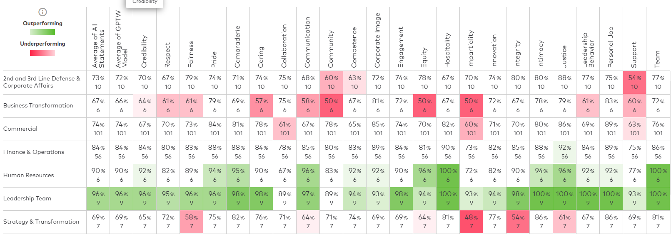
Key Dimensions Score – Department wise

Slide 31
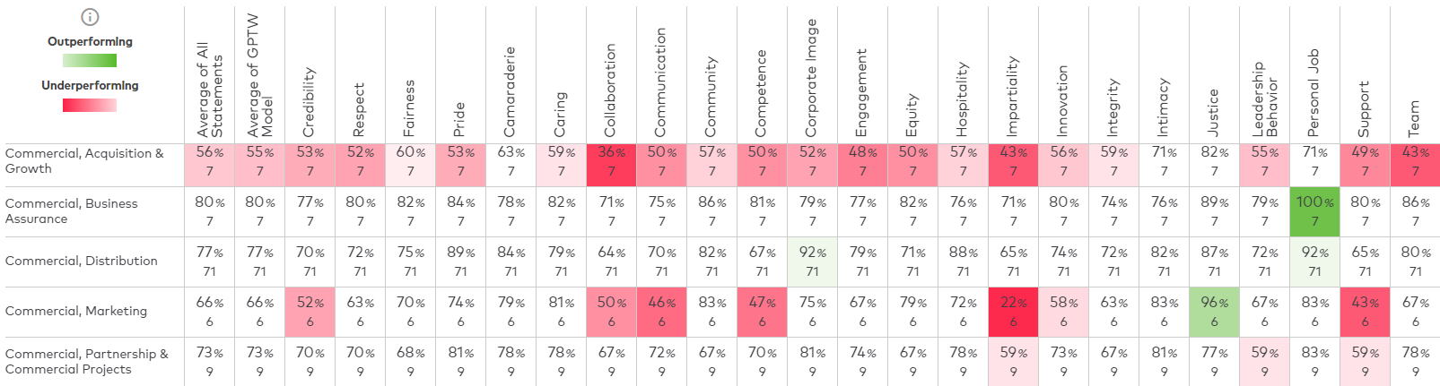
Key Dimensions Score – Team wise [Page 1]
Key dimensions score in team breakdown fashion is available only for Commercial, Finance & Operations and Technology department.
The score of teams with less than 5 respondents are not available.

Slide 32
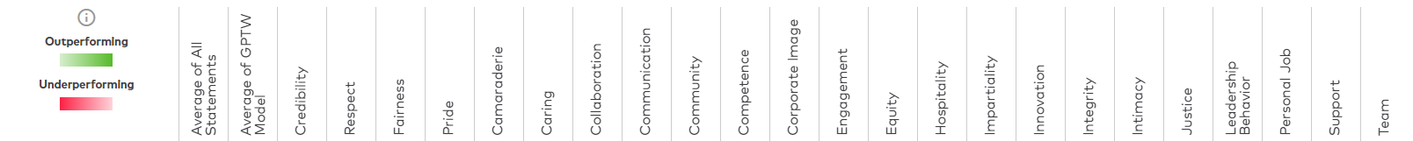
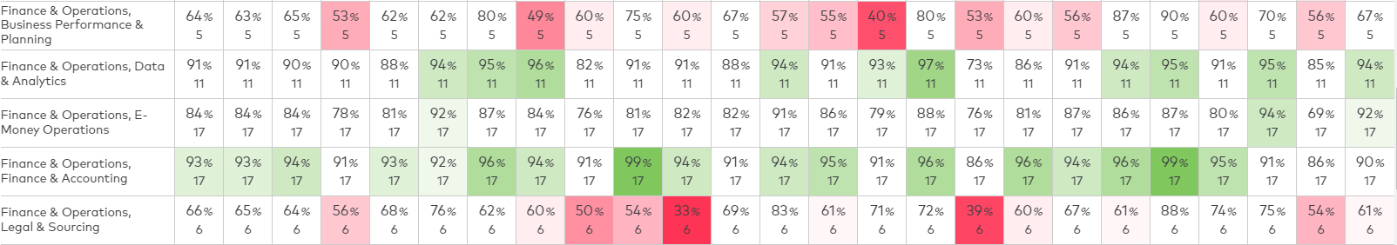
Key Dimensions Score – Team wise [Page 2]
Key dimensions score in team breakdown fashion is available only for Commercial, Finance & Operations and Technology department.
The score of teams with less than 5 respondents are not available.

Slide 33
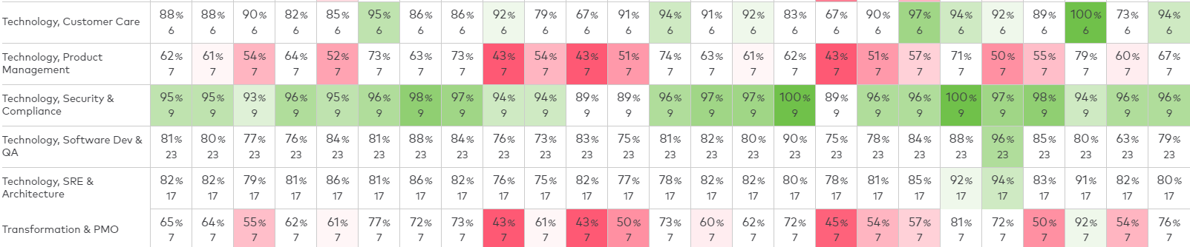
Key Dimensions Score – Team wise [Page 3]
Key dimensions score in team breakdown fashion is available only for Commercial, Finance & Operations and Technology department.
The score of teams with less than 5 respondents are not available.

Slide 34
Internal Benchmark with previous year(s) results

Slide 35
2 Years Employee Survey Score – Internal Benchmark

Slide 36
External Benchmark with available GPTW industry data

Slide 37
Overall Great Place To Work Score [Industry Benchmark]
Remark – up to date industry data not available by the provider.
The industry benchmarking for Employee Survey Scores are also not available as it is inclusive of customed statements added by us.

Slide 38
Key Dimensions Score [Industry Benchmark]

Slide 39
Sentiment Analysis on Open-ended Question Comments

Slide 40
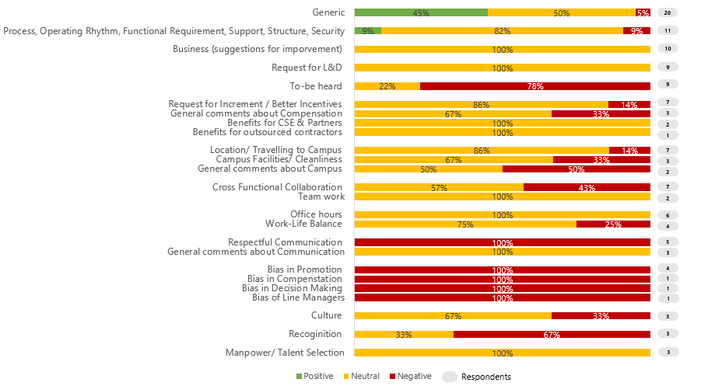
Q1: If you could change one thing about this company to make it a better place to work, what would it be?

Slide 41
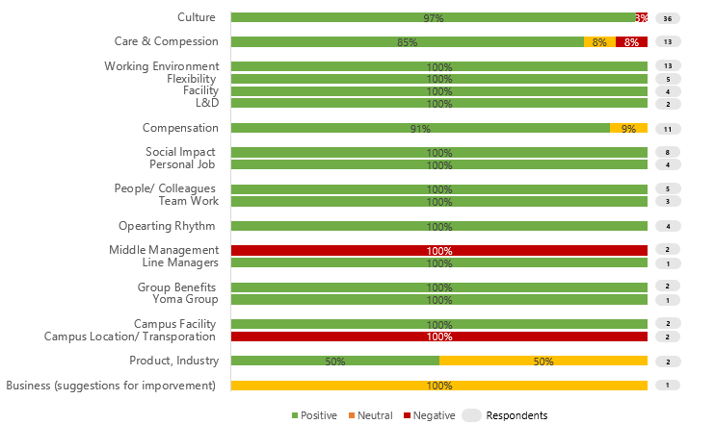
Q2: Is there anything unique or unusual about this company that makes it a great place to work. Please give specific examples.

Slide 42

THANK YOU

